Slide 1
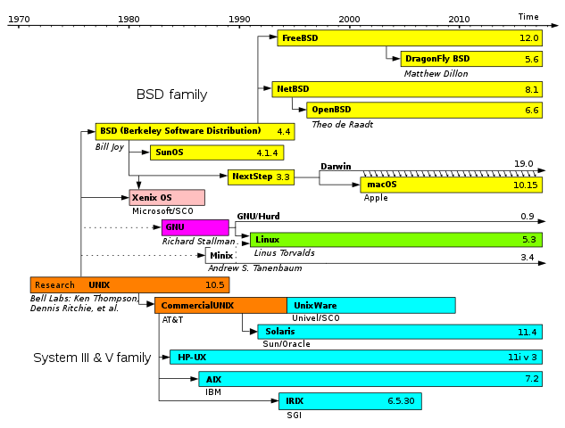
Introduction to System Programming C Pointers

Slide 2
Goals of this Lecture
Help you learn about pointers:
Memory and addresses
Pointers and applications
Pointer variables
Pointer operators
Relation to arrays
Mastering pointers is difficult
Often dangerous if not careful
Requires (lots of) practice to internalize it
But efficient and convenient if you do know it

Slide 3
A Close Look at C Variable
int i;
i = 1;
Elements of a variable
Name: ‘i’ is the name
Value: often changes over time
Address: memory location where its value is stored
i.e., the start address of consecutive bytes
Pointer variable
A special variable whose value is an address
Called “X” (type) pointer
int pointer, char pointer, long pointer, etc.
Its value is interpreted as the start address of type X

Slide 4
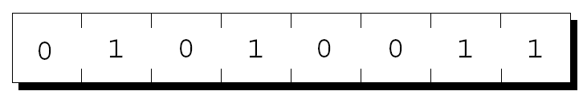
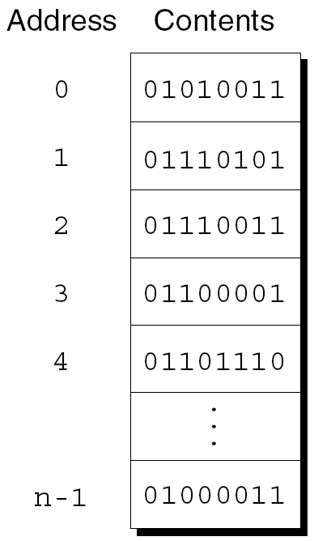
Memory and Address
Main memory is divided into bytes
Each byte stores eight bits of information
Each byte has a unique address
Layout of n-byte memory
Addresses range from 0 to n – 1:

Slide 5
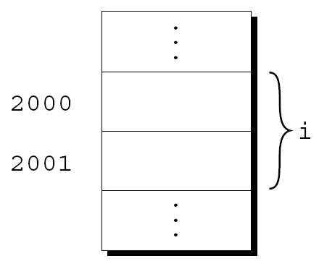
C Variable and its Address
Each variable occupies one or more bytes of memory
The address of the first byte is said to be the address of the variable
e.g., the address of the variable i is 2000:

Slide 6
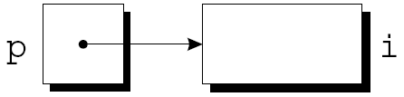
Pointer Variable
A special variable that holds an address
When we store the address of a variable i in the pointer variable p, we say that p “points to” i
A graphical representation:
Pointer variable declaration
Name preceded by an asterisk (*) indicates that it is a pointer
p is capable of pointing to memory storing data of type int
q is capable of pointing to memory storing data of type float
int *p;
float *q;

Slide 7
Declaring Pointer Variables
Can be declared along with other variables
Every pointer variable should point only to memory storing a particular type (called referenced type):
No restrictions on referenced types
int i, j, a[10], b[20], *p, *q;
int *p; /* points only to integers */
double *q; /* points only to doubles */
char *r; /* points only to characters */
struct student *p; /* points to a struct type */
int **p; /* points to pointers to integers*/
int (*p)[10]; /* points to integer array of size 10 */
int *p[10] ; /* array of ten integer pointers */

Slide 8
Pointer Operators: &, *
& operator
To find the address of a variable
Called address operator
* operator
To read the data that a pointer points to
Called indirection/dereference operator
Don’t be confused with pointer declaration

Slide 9
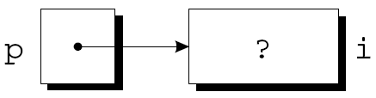
The Address Operator (&)
Declaring a pointer variable
Allocates 8 byte (64bit machine) memory to store a pointer value
Declaration doesn’t make it point to anywhere in the memory yet
Crucial to initialize p before using it
Can assign the address of a variable with & operator
Address assignment makes p to point to i
Can initialize a pointer variable at declaration
int *p; /* points nowhere in particular */
int i, *p;
...
p = &i; /* ‘&’ returns the address of i */
int i;
int *p = &i;
int i, *p = &i; /* valid if ‘i’ is declared before p*/
int *p = &i, i; /* so, this is invalid */

Slide 10
The Indirection Operator (*)
int i;
int *p = &i;
printf("%d\n", *p); /* prints out the value of i */
&: produces a pointer to the variable
*: reads what’s stored in the memory address
If p points to i:
*p has the same value as i
Changing the value of *p changes the value of i
Examples are in the next slide
j = *&i; /* same as j = i; */

Slide 11
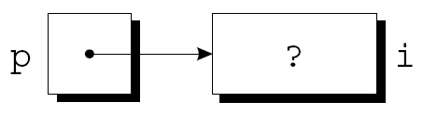
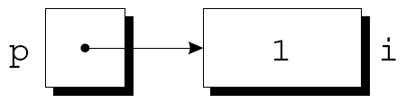
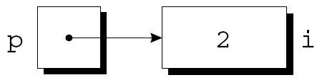



The Indirection Operator (*)
p = &i;
i = 1;
printf("%d\n", i); /* prints 1 */
printf("%d\n", *p); /* prints 1 */
*p = 2;
printf("%d\n", i); /* prints 2 */
printf("%d\n", *p); /* prints 2 */

Slide 12
Dangerous Usage of * Operator
Applying * to uninitialized pointer is dangerous
Why dangerous?
It is a logically wrong statement
Reading or writing a value at a random address is prohibited by the operating system (protection)
Operating system stops a program that misbehaves
Will learn the reasons later in the course
int *p;
printf("%d", *p); /*** WRONG ***/
/* the following is even more dangerous */
*p = 1; /*** WRONG ***/

Slide 13
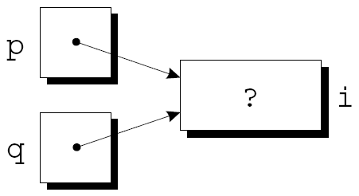

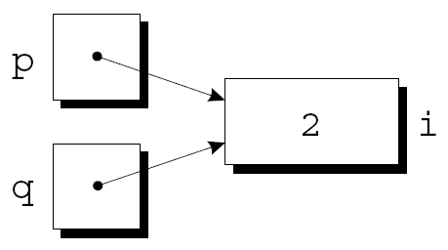
Pointer Assignment
A pointer can be assigned to another pointer of the same type
Any number of pointer variables may point to the same memory space
int i, j, *p, *q;
p = &i;
q = p; /* p and q both point to i */
*p = 1;
*q = 2;

Slide 14
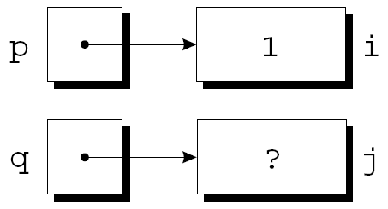
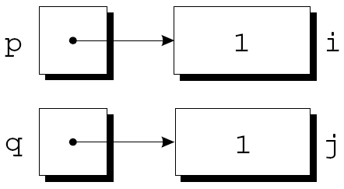
Pointer Assignment
How different are these two statements?
An example for the second case
q = p;
*q = *p;
p = &i;
q = &j;
i = 1;
*q = *p;

Slide 15
Pointer as Argument
scanf takes pointers as arguments
Without &, value of i is provided to scanf
What does scanf do with “%d”?
Converts an input string to an integer
Writes it to the provided address
Arguments need to be pointers
Doesn’t mean & is always needed
i.e., sometimes it is wrong to use &
int i;
...
scanf("%d", &i);
int i, *p;
...
p = &i;
scanf("%d", p);
scanf("%d", &p); /** WRONG **/

Slide 16
Pointers as Return Values
Functions are allowed to return pointers:
After the call, p points to either i or j
int *max(int *a, int *b)
{
return (*a > *b) ? a : b;
}
int *p, i, j;
...
p = max(&i, &j);

Slide 17
Pointers as Return Values
What’s wrong with the following function?
i and j are passed to local variables of the function
Function will return memory address of the local variable
When it returns, the memory area of the function local variable will be deallocated ➔ returned memory address may hold garbage values
int *max(int a, int b)
{
return (a > b) ? &a : &b;
}
int *p, i, j;
...
p = max(i, j);

Slide 18
Array and Pointer Relationship
&a[i] is a pointer to element i of array a
Often useful to return a pointer to an array element
A function that returns a pointer to the middle element of a, assuming that a has n elements:
int *find_middle(int a[], int n)
{
return &a[n/2];
}

Slide 19
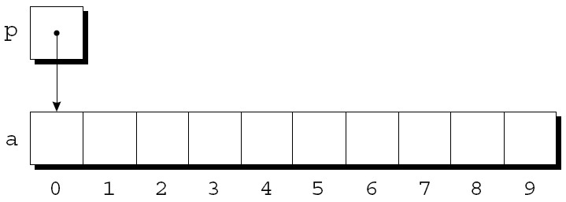
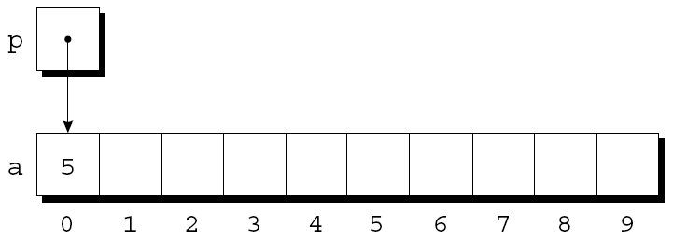
Array and Pointer Relationship
Accessing array elements with pointers
Access a[0] through p;
*p = 5;
An updated picture:
int a[10], *p;
p = &a[0];

Slide 20
Pointer Arithmetic
Pointer Arithmetic simplifies access to array elements with pointers
C supports three forms of pointer arithmetic:
Adding an integer to a pointer
Subtracting an integer from a pointer
Subtracting one pointer from another

Slide 21
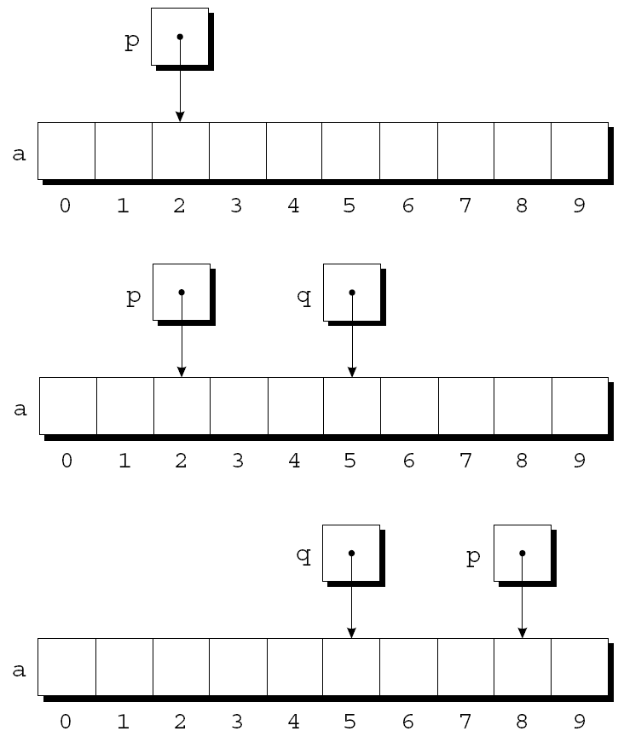
Adding an Integer to a Pointer
p + j points to j places after the one p points to
If p points to a[i], then p + j points to a[i+j]
int a[10], *p, *q, i;
p = &a[2];
q = p + 3;
p += 6;

Slide 22
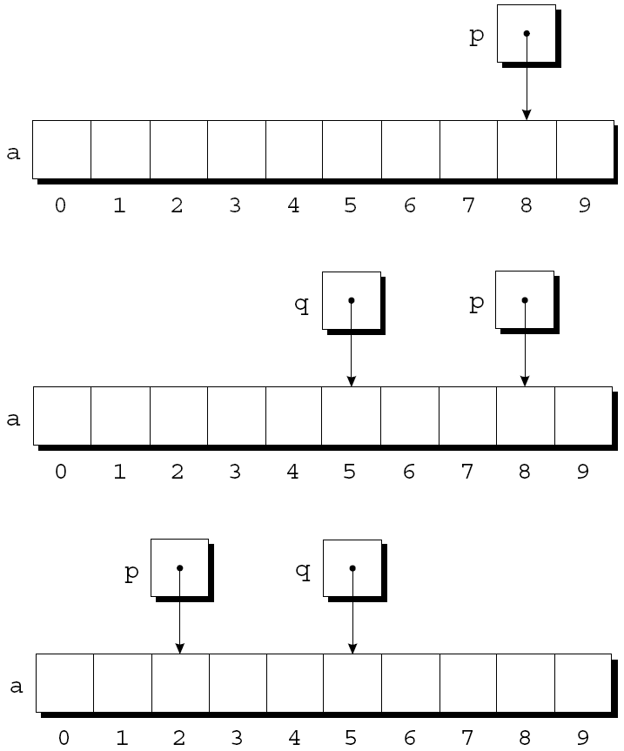
Subtracting an Integer from a Pointer
If p points to a[i], then p - j points to a[i-j]
p = &a[8];
q = p - 3;
p -= 6;

Slide 23
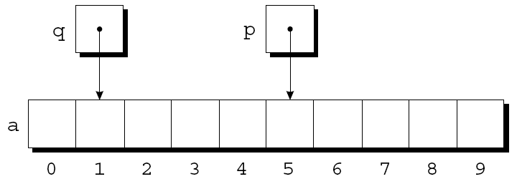
Subtracting One Pointer from Another
The result is the distance (measured in array elements) between the pointers
If p and q point to a[i] and a[j], p - q is equal to i – j
Operations that cause undefined behavior:
Performing pointer arithmetic that doesn’t point to an array element
Subtracting pointers unless both point to elements of the same array
p = &a[5];
q = &a[1];
i = p - q; /* i is 4 */
i = q - p; /* i is -4 */

Slide 24
Comparing Pointers
Operations using relational or equality operators
<, <=, >, >=,==, and !=
Meaningful only for pointers to elements of the same array
Outcome depends on the relative positions of the two elements
p = &a[5];
q = &a[1];
What is the outcome of (p <= q)? 0
What about (p >= q)? 1

Slide 25
Using an Array Name as a Pointer
The name of an array can be used as a pointer to the first element in the array
a+i is the same as &a[i]
*(a+i)is the same as a[i]
An array name cannot be assigned a new value
This is because array name is not a pointer variable
Use a pointer variable to do this
int a[10];
*a = 7; /* stores 7 in a[0] */
*(a+1) = 12; /* stores 12 in a[1] */
while (*a != 0)
a++; /*** compile error ***/
int *p = a;
while (*p != 0)
p++;

Slide 26
Array Arguments
An array name is passed as a pointer
int find_largest(int a[], int n)
{
int i, max;
max = a[0];
for (i = 1; i < n; i++)
if (a[i] > max)
max = a[i];
return max;
}
int b[10];
int c = find_largest(b, 10)

Slide 27
Array Arguments
Consequence 1: An array argument isn’t protected against change in its element
Use const if a function should not change the array
Compiler produces an error if any element of a is changed
int find_largest(const int a[], int n)
{
...
}

Slide 28
Array Arguments
Consequence 2: The time required to pass an array to a function doesn’t depend on the size of the array
There’s no penalty for passing a large array, since no copy of the array is made
Consequence 3: An array parameter can be declared as a pointer if desired
Identical to declaring as int a[]
Except that a itself cannot be modified since it is an array name
int find_largest(int *a, int n)
{
...
}

Slide 29
Array Arguments
Consequence 4: A function with an array parameter can be passed an array “slice”—a sequence of consecutive elements
An example that applies find_largest to elements 5 through 14 of an array b:
largest = find_largest(&b[5], 10);

Slide 30
Array Declaration vs. Pointer Declaration
The following declaration causes the compiler to set aside space for 10 integers and assign the address of first element to a
int a[10];
*a = 0; /* What happens? */ a[0]=0 로 잘 정의됨.
The following declaration causes the compiler to allocate space for a pointer variable:
int *a;
*a = 0; /* What happens? */ error. Undefined memory locaation.

Slide 31
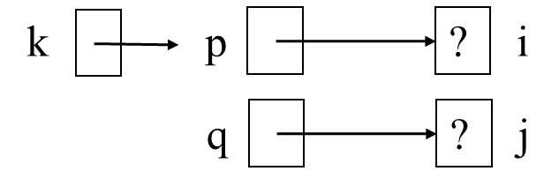
Double Pointer
int i, j;
int *p = &i, *q = &j;
int **k = &p;

Slide 32
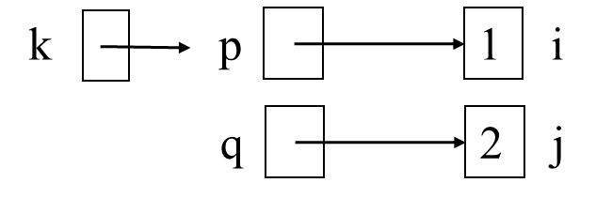
Double Pointer
int i, j;
int *p = &i, *q = &j;
int **k = &p;
*p = 1; // i = 1;
*q = 2; // j = 2;

Slide 33
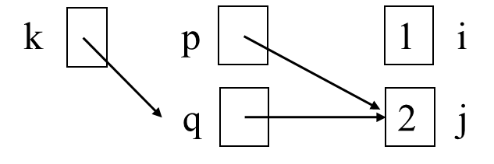
Double Pointer
int i, j;
int *p = &i, *q = &j;
int **k = &p;
*p = 1; // i = 1;
*q = 2; // j = 2;
*k = q; // p = q;
k = &q; // k points to q

Slide 34
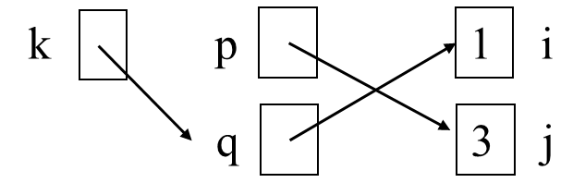
Double Pointer
int i, j;
int *p = &i, *q = &j;
int **k = &p;
*p = 1; // i = 1;
*q = 2; // j = 2;
*k = q; // p = q;
k = &q; // k points to q
*k = &i; // q = &i;
*p = 3; // j = 3;

Slide 35
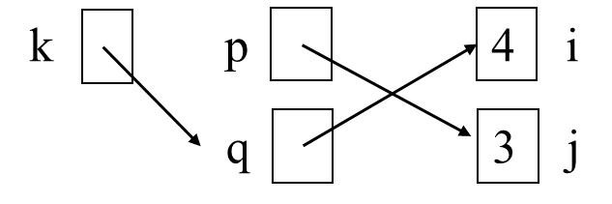
Double Pointer
int i, j;
int *p = &i, *q = &j;
int **k = &p;
*p = 1; // i = 1;
*q = 2; // j = 2;
*k = q; // p = q;
k = &q; // k points to q
*k = &i; // q = &i;
*p = 3; // j = 3;
**k = 4; // i = 4;

Slide 36
Complex Pointer Declarations
Rule: [], () takes precedence over *, but parenthesis has the highest priority
https://cseweb.ucsd.edu/~ricko/rt_lt.rule.html
Strategy: start with identifier, from inside to outside
int *p[10];
// p is an array([]) of 10 int pointers
int (*p)[10];
// p is a pointer (*) to array of 10 integers
int *(*p)[10];
// p is a pointer (*) to array of 10 int pointers
int (*pf)(void);
// pf is a pointer to a function returning int
int *pf(void);
// pf is a function that returns int pointer (int *)
int (*pf[10])(void);
// pf is an array of 10 pointers to function returning int
int pf[](void);
// pf is an array of functions that returns an int (ILLEGAL)

Slide 37
Pointer Exercise
Pointers is an efficient and essential tool in C programming
But can be very confusing -- only practice makes perfect!
 | An |  |  | *An |  |  | **An
 | Compiles (Y/N) | Potential bad pointer dereference (Y/N) | sizeof() | Compiles (Y/N) | Potential bad pointer dereference (Y/N) | sizeof() | Compiles (Y/N) | Potential bad pointer dereference (Y/N) | sizeof()
int A1[3]
int *A2[3]
int (*A3)[3]

Slide 38
Pointer Exercise Solution
 | An |  |  | *An |  |  | **An
 | Compiles (Y/N) | Potential bad pointer dereference (Y/N) | sizeof() | Compiles (Y/N) | Potential bad pointer dereference (Y/N) | sizeof() | Compiles (Y/N) | Potential bad pointer dereference (Y/N) | sizeof()
int A1[3] | Y | N | 12 | Y | N | 4 | N | N/A | N/A
int *A2[3] | Y | N | 24 | Y | N | 8 | Y | Y | 4
int (*A3)[3] | Y | N | 8 | Y | Y | 12 | Y | Y | 4
int A1[3]: array of three integers ➔ *A1: A1[0] ➔ **A1: N/A
int *A2[3]: array of three pointers to integers ➔ *A2: A2[0] ➔ **A2: integer value of the first pointer element (A2[0])
Int (*A3)[3]: pointer to an array of 3 integers ➔ *A3: array of three integers ➔ **A3: A3[0]

Slide 39
Pointer Exercise Solution
 | An |  |  | *An |  |  | **An
 | Compiles (Y/N) | Potential bad pointer dereference (Y/N) | sizeof() | Compiles (Y/N) | Potential bad pointer dereference (Y/N) | sizeof() | Compiles (Y/N) | Potential bad pointer dereference (Y/N) | sizeof()
int A1[3] | Y | N | 12 | Y | N | 4 | N | N/A | N/A
int *A2[3] | Y | N | 24 | Y | N | 8 | Y | Y | 4
int (*A3)[3] | Y | N | 8 | Y or N | Y | 12 | Y | Y | 4
int A[3] = {1, 2, 3}, B[3] = {4, 5, 6};
int (*A3)[3], (*B3)[3], *pA;
A3 = &A; B3 = &B;
*A3 = *B3; // compile error as it’s the same as A = B
**A3 = **B3; // fine, same as A[0] = B[0]
pA = *A3; // fine, same as pA = A;

Slide 40
Summary
Pointers and their operations
Pointer has a memory address as its value
& is address operator
* is indirection/dereference operator
Pointers as function arguments
Typically used to change the value of the passed variable
Call-by-reference semantics
Relation to the arrays
Array name can be used as a pointer assigned with the address of its first element

